Slide 1
CCNA 200-301
Network Address Translation

Slide 2
Objectives
Configure and verify inside source NAT using static and pools

Slide 3
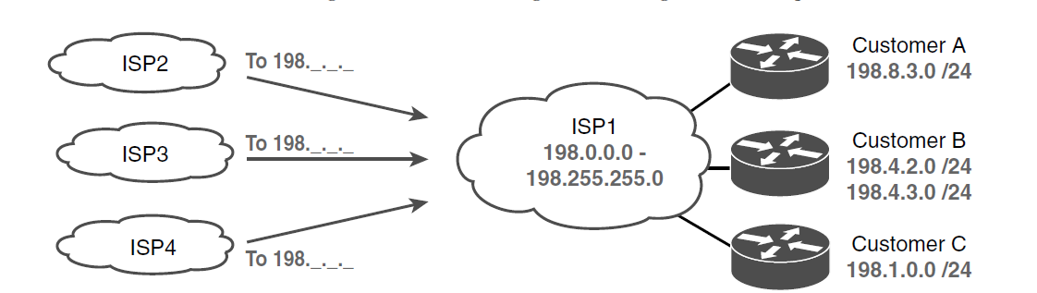
Typical Use of CIDR

Slide 4
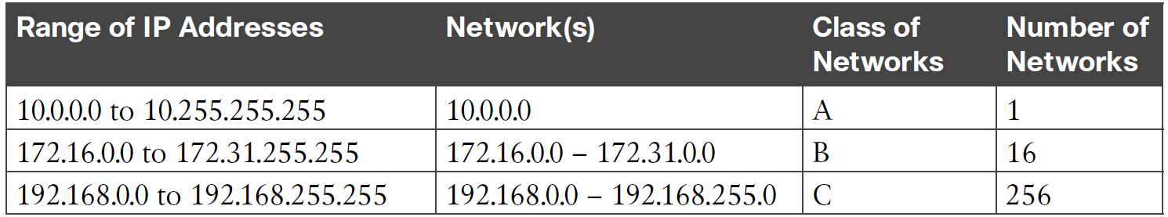
RFC 1918 Private Address Space

Slide 5
Three Important Functions that Extend the Life of IPv4
Feature | RFC(s) | Main Benefits
CIDR* | 4632 | Assign more-specific public Ipv4 address blocks to companies than Class A, B, and C networks. Aggregate routes to public IPv4 addresses based on worldwide address allocation plan.
NAT* | 3022 | Enable approximately 65,000 TCP/UDP sessions to be supported by a single public IPv4 address.
Private networks | 1918 | Enable the use of NAT for enterprise Internet connections, with private addresses used inside the enterprise.
*CIDR and NAT may be better known for their original RFCs (1518, 1519 for CIDR;
1631 for NAT)

Slide 6
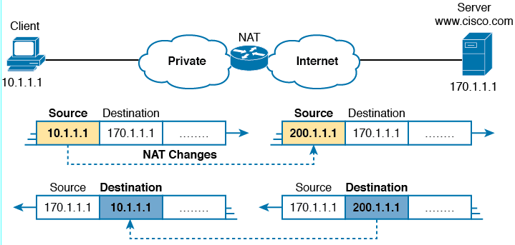
NAT IPv4 Address Swapping: Private Addressing

Slide 7
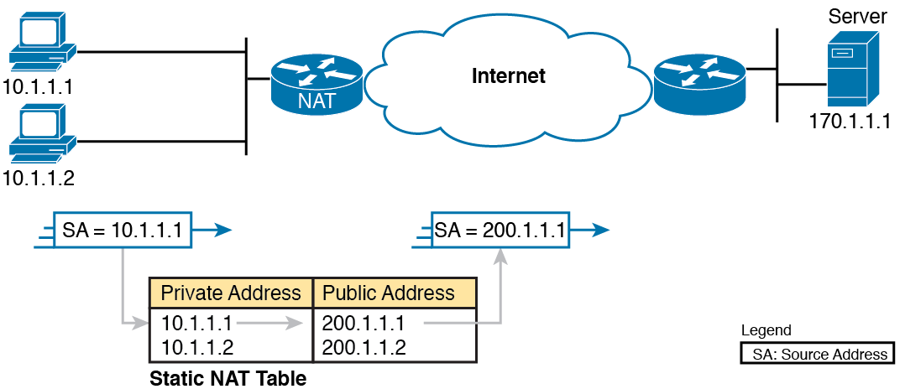
Static NAT Showing Inside Local and Global Addresses

Slide 8
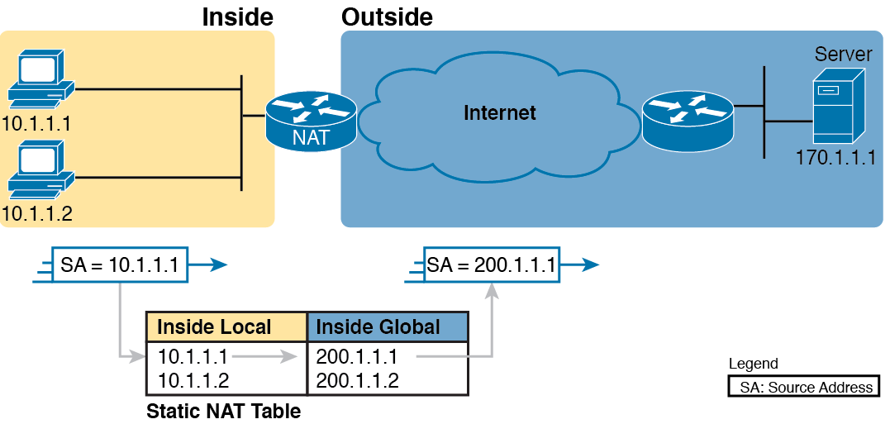
Static NAT Terminology

Slide 9
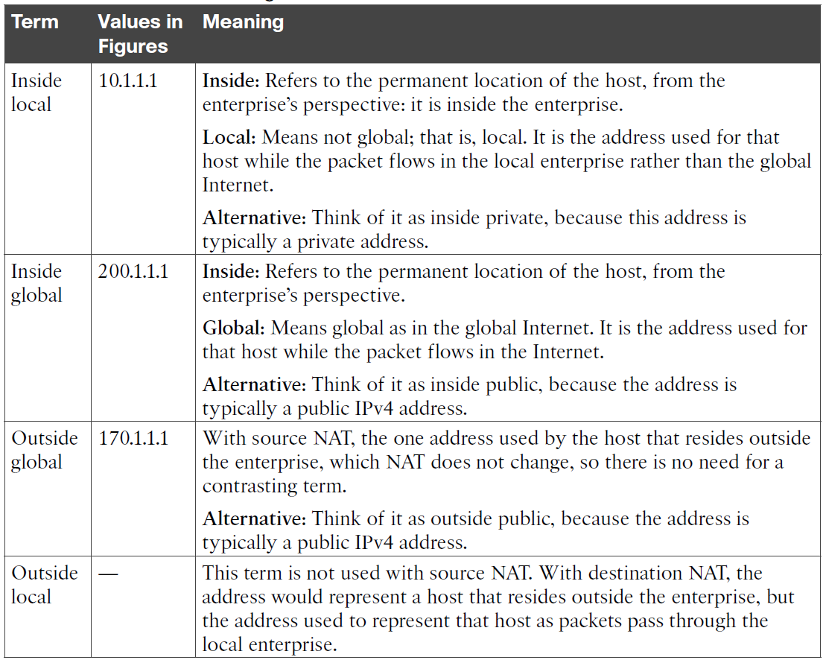
NAT Addressing Terms

Slide 10
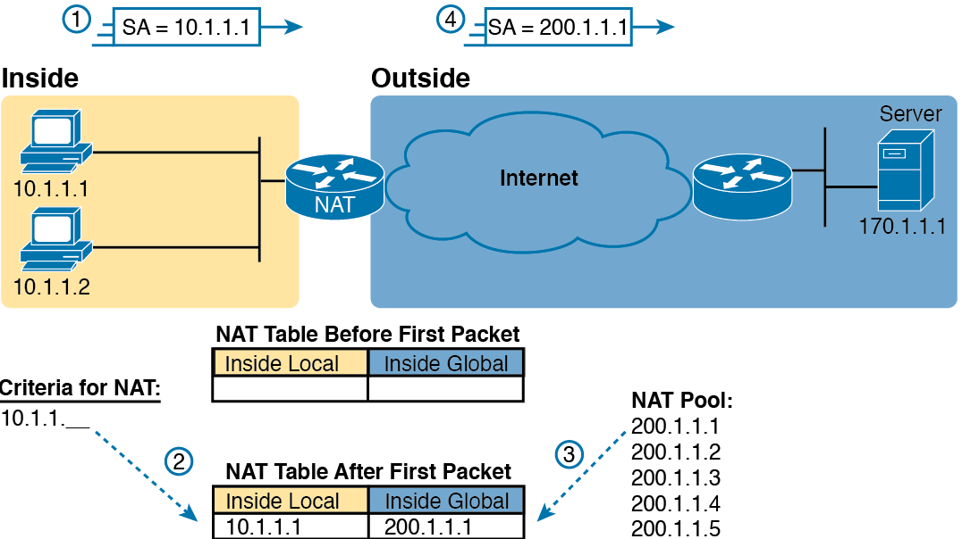
Dynamic NAT

Slide 11
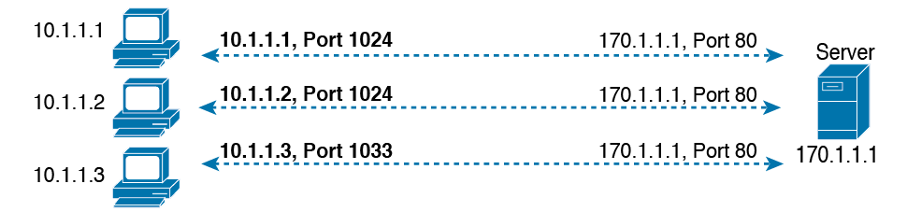
Three TCP Connections from Three PCs

Slide 12
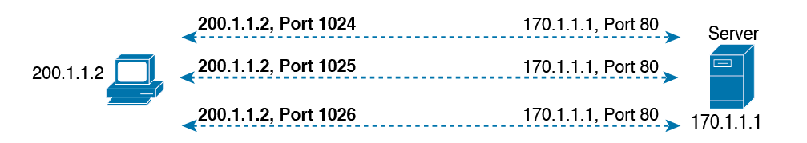
Three TCP Connections from One PC

Slide 13
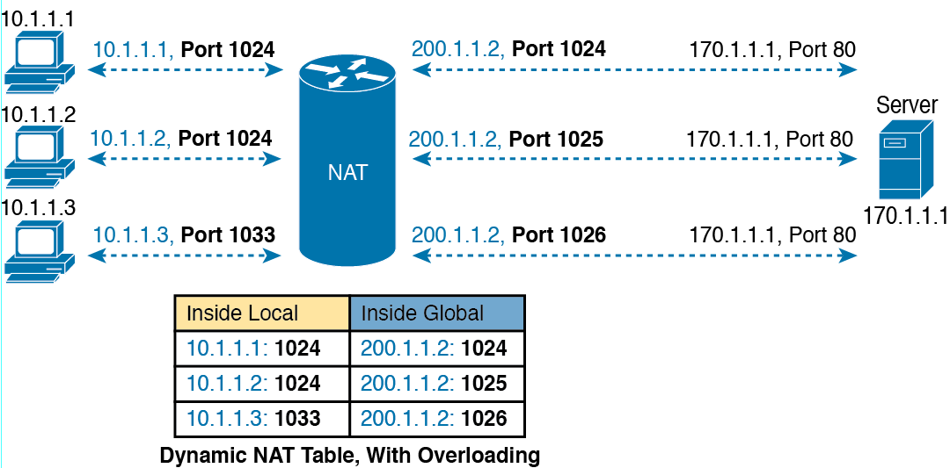
NAT Overload (PAT)

Slide 14
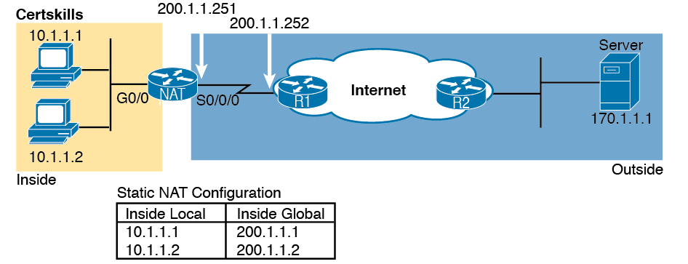
Sample Network for NAT Examples, with Public Class C 200.1.1.0/24

Slide 15
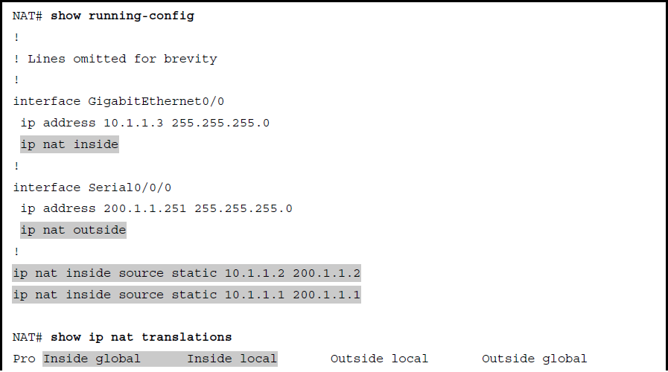
Static NAT Configuration

Slide 16
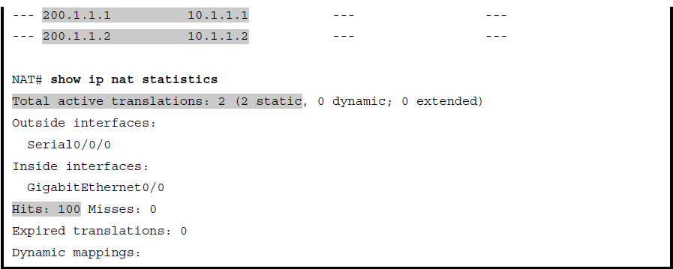
Static NAT Configuration (continued)

Slide 17
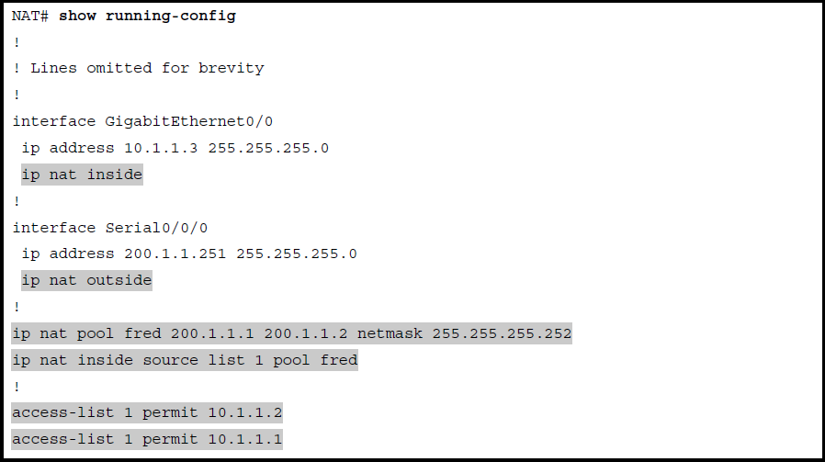
Dynamic NAT Configuration

Slide 18
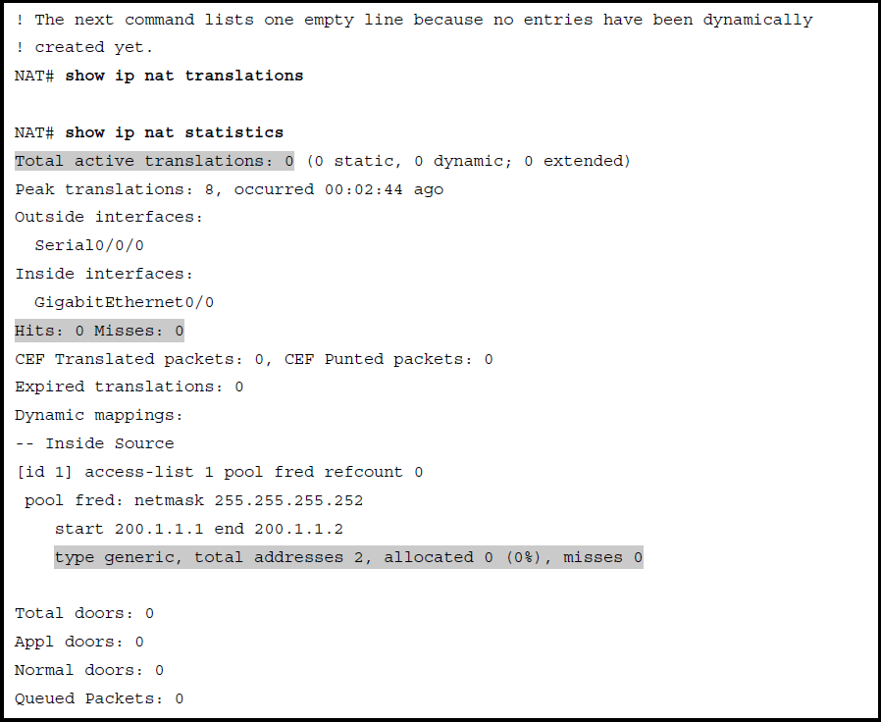
Dynamic NAT Verifications Before Generating Traffic

Slide 19
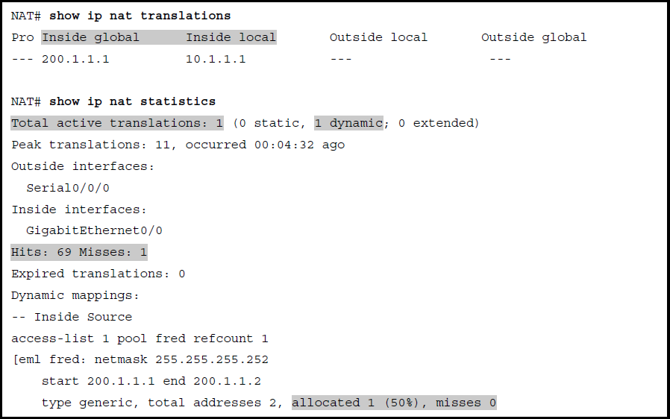
Dynamic NAT Verifications After Generating Traffic

Slide 20
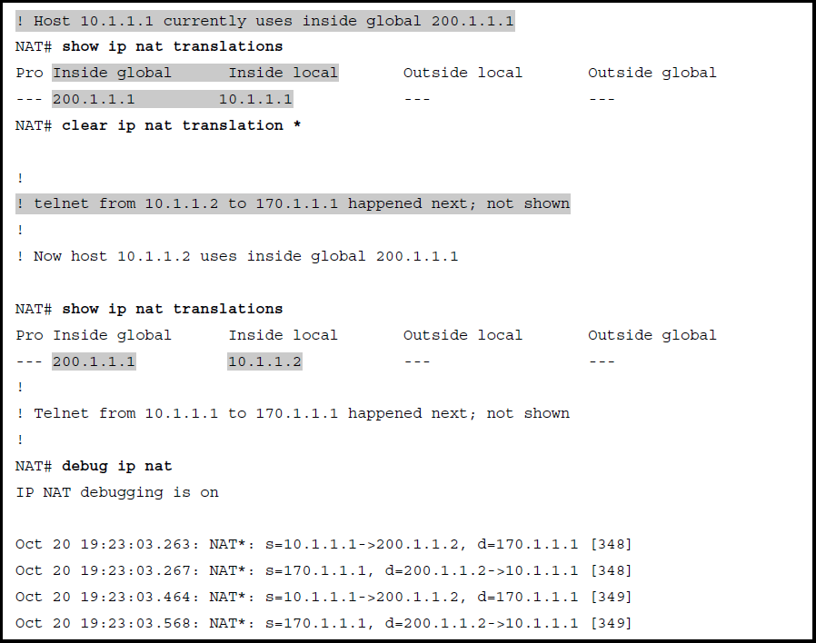
Example of Reuse of a Dynamic Inside Global IP Address

Slide 21
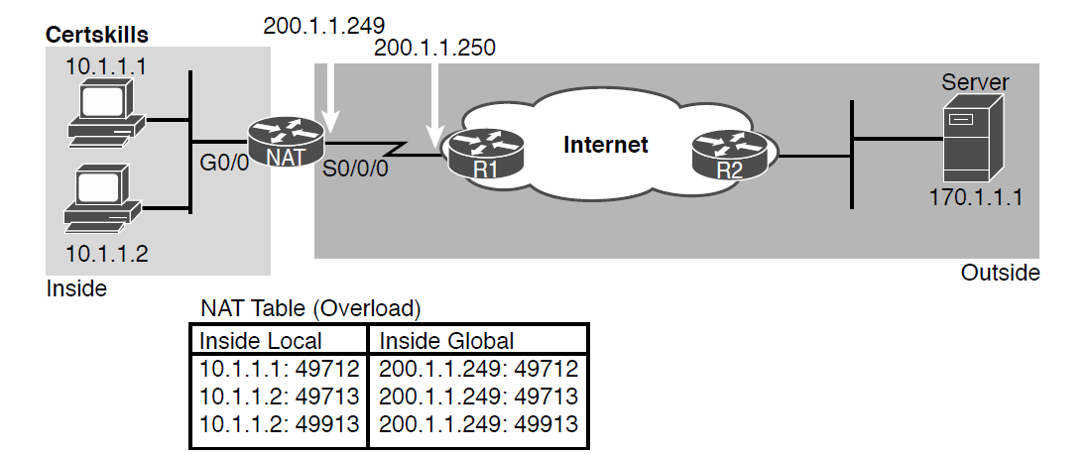
NAT Overload and PAT

Slide 22
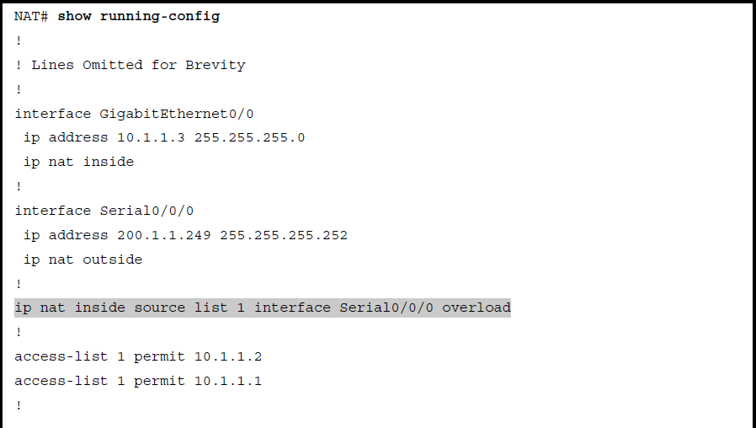
NAT Overload Configuration

Slide 23
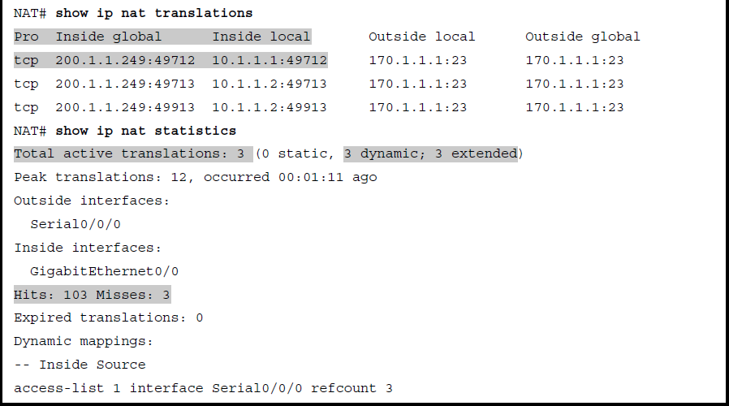
NAT Overload Configuration (continued)

Slide 24
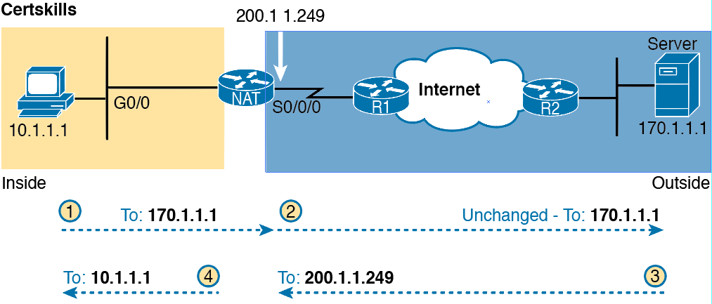
Destination Address Changes on Outside to Inside (Only) with Source NAT

Slide 25
NAT Troubleshooting
Reversed inside and outside
Static NAT
Dynamic NAT (ACL)
Dynamic NAT (pool)
PAT
ACL
User traffic required
IPv4 routing

